Slide 1
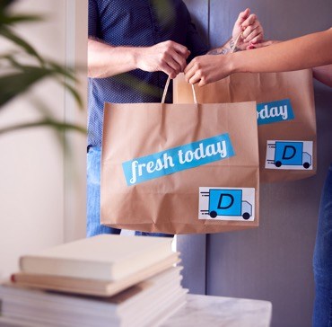
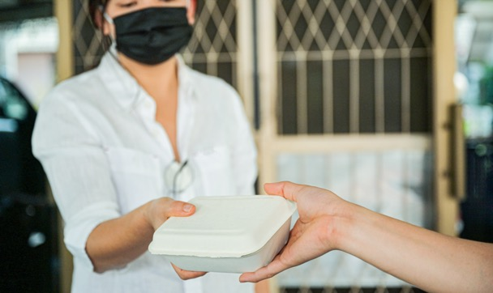
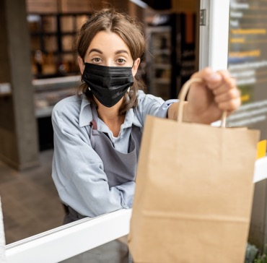
FOODBACK
SOME HELP HAS ARRIVED
Levy Restaurants
Thursday January 21, 2021

Slide 2
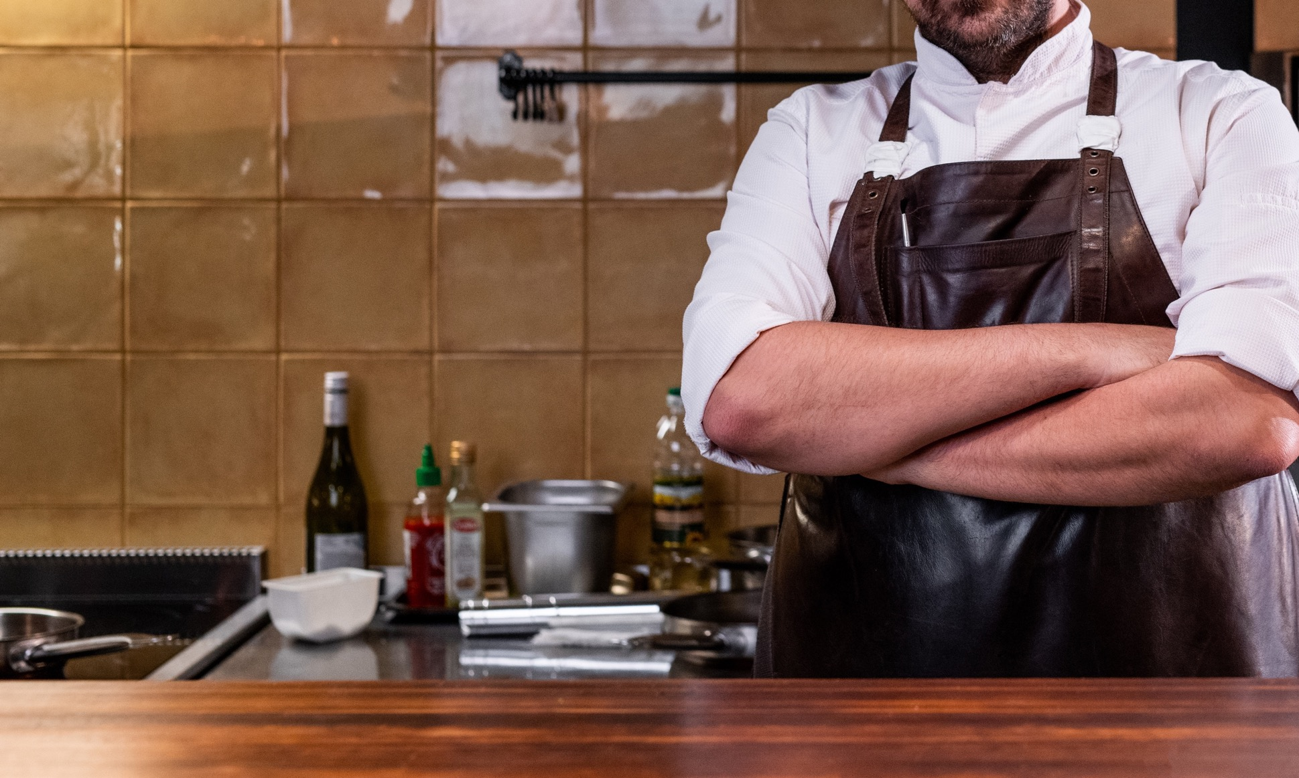
WE’RE HERE
TO HELP BRAVE
F&B BUSINESSES
‘STAY IN THE FIGHT’
In strange times,
Engage and connect more
Easily know more, quicker
Notes:
We know it aint easy out there right now.
So much coming at you, very little to help you….. We’re here to change that and lend a hand to your business…..

Slide 3
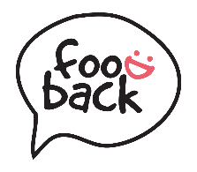
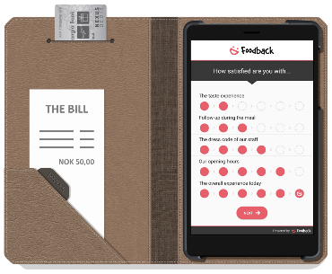
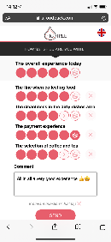
Data / Feedback Collection
Perfectly Timed - Always
Table Service
Use our optional unique Bill Folder to capture quick and fresh feedback while handing out the bill. This method has a response rate of 90%.
F&B – Anywhere
Regardless of where you serve, we get the attention of your customers at just the right time. It’s all done in under a minute!
QR Codes
On tables, receipts, packaging. Anywhere you serve your food.
Regardless of how you get your customers' attention, they all receive the same quick and user friendly feedback experience.
Near Field Communication
Enable customers to simply tap their phone and give feedback.
Foodback API
Integrate for full flexibility. Feedback via SMS, push, web, apps ++
SUITED FOR
SUITED FOR
Fine Dine / Table Service
Table Service
Take Away
Canteens
Food Courts
Breakfast
Diner/Café
Anywhere
Notes:
- Table service & pre-paid meals → new

Slide 4
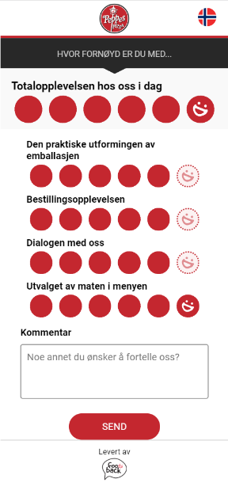
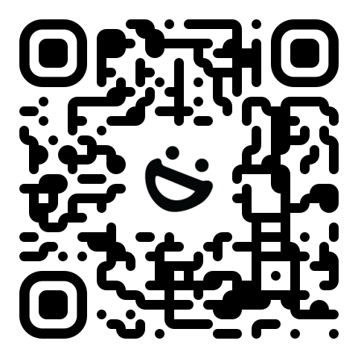
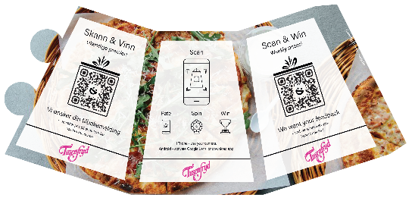
SHORT DECK
Collect
Try Yourself: click or scan the QR code
HOW TO
iPhone
Open camera, scan and tap the drop-down
Android
Activate Google Lens and scan
Older Android? Download a QR app
https://qr.foodback.com/DRZe6W
https://qr.foodback.com/MGO1ob
The process is clearly communicated to your customers
Notes:
Fredrik: Finner how-to-guide eks Daniel: limer inn og får det til å se bra ut (høyre side) - Egen QR code slide: eksempler med bordrytter, plakat, klistremerke, business cards (stående med clipper)

Slide 5
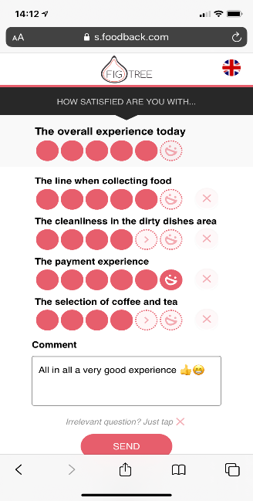
Kai Hansen
PhD – Meal Experiences
Easy, Customizable Engine
- A few quick questions, but actually many (!)
- For any user flow (in-App, out-of-App, online, 3rd Party, etc.)
Heidi Skeiseid
PhD – Consumer Behaviour
Unique smart engine asks overall experience (NPS*) + 4 randomly selected questions from your buckets, creating a fast user experience, and still broad insights for you
The overall experience today
1
5
Meal
2
Service
3
Feel
4
Place
5
The taste experience
Our selection of food
Our opening hours
The serving temperature
The size of the portions
And more…
How we welcomed you
Our knowledge about the food
Follow-up during the meal
Delivery time of the food
Delivery time of the beverages
How we cleared the table
And more…
The dress code of our staff
The human touch of our service
The lighting
The volume of the music
The acoustics (sound)
The temperature inside
And more…
Our opening hours
How the table was set
Cleanliness of the restrooms
Our interior and décor
The seating comfort
And more…
Standard
&
Custom questions

Slide 6
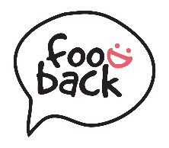
Collect
Timing Is Everything
Time of Meal
1 HOUR
AFTER MEAL
Feedback Quantity & Quality
Time Since Meal

Slide 7
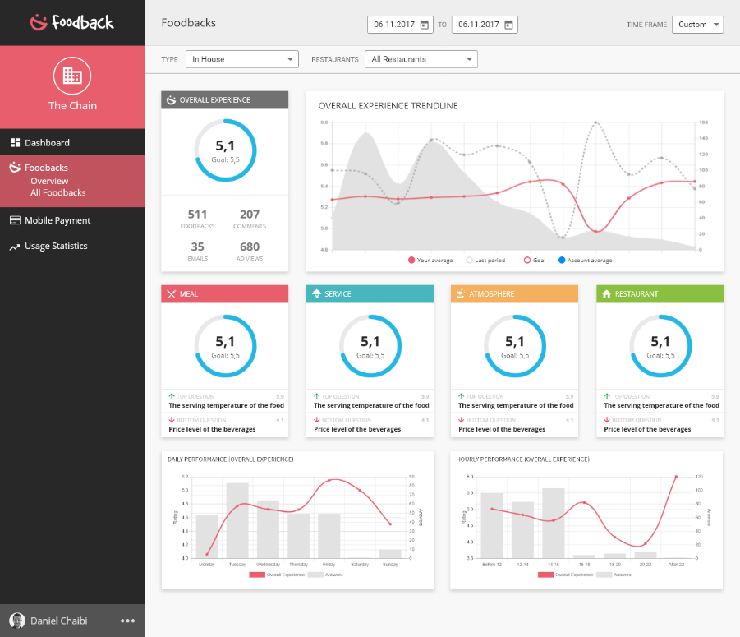
Analyze
Dive Into the Details
Built-in close collaboration with clients
Delivering value from day one!
ANALYTICS
Super easy, designed for busy people
Dashboards
Blazingly fast drill-down
Custom statistics
Trendlines
MULTIPLE VENUES
Improve transparency across your business
Goals (KPIs)
Benchmarking
Segmentation
Flexible configuration
Real-time, 24/7

Slide 8
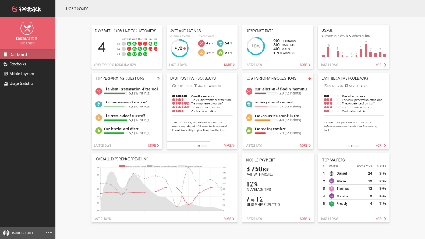
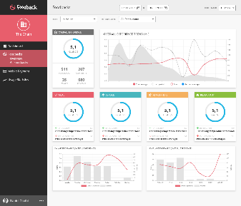
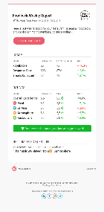
Standard Prices
For single venues
SETUP
SUBSCRIPTION
SETUP
USD 100 per venue
INPUT METHODS
QR PRINT
USD 2 per table tent
API / INTEGRATION
Let’s talk
FOODBACK ANALYTICS
USD 59
per month / per venue

Slide 9
Compass Group Prices
SETUP
SUBSCRIPTION
SETUP
USD 60 per venue
INPUT METHODS
QR PRINT
USD 1 per table tent
API / INTEGRATION
Let’s talk
FOODBACK ANALYTICS
USD 35
per month / per venue

Slide 10
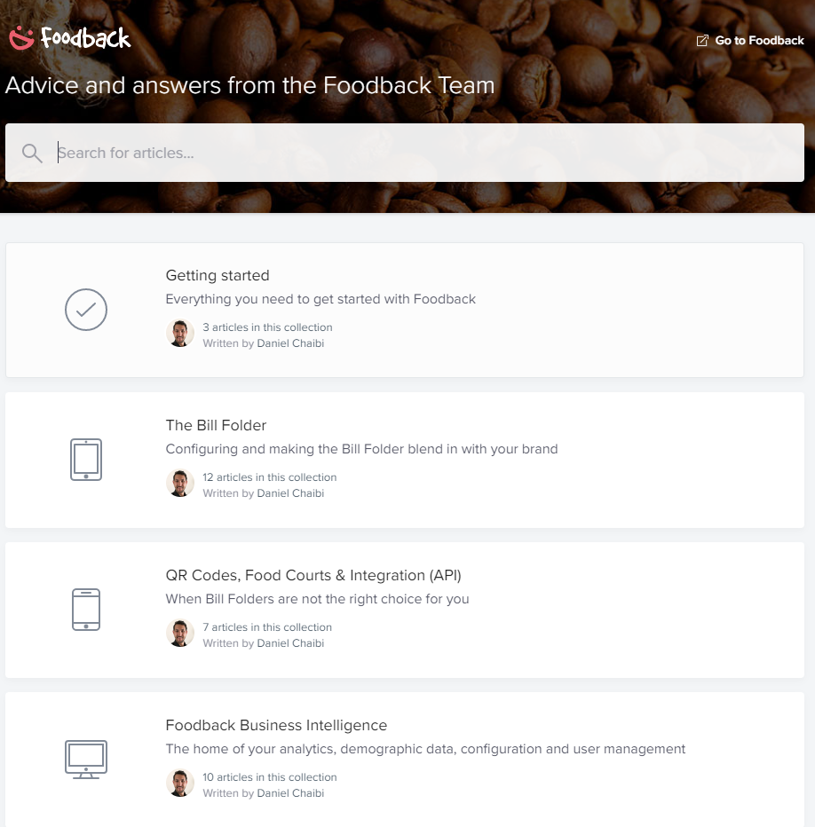
Implementation & onboarding plan
For Levy, online in 2-3 weeks
DESIGN – 1-2 weeks
Choose collection method (table tents, stickers, posters etc.)
Custom design for Levy and each F&B concept
QR material distribution to sites, approx. 1 week
SETUP/CONFIGURATION – 1-2 weeks
Tailor made question sets for each site
User access, rewards, ad space
IMPLEMENTATION & SUPPORT – 1-2 weeks
Implementation/training meetings for relevant Levy employees
Support:
Live chat
Own support page: help.foodback.com
Dedicated account manager
TOTAL IMPLEMENTATION TIME
2-4 weeks with minimal administrative work from Levy

Slide 11
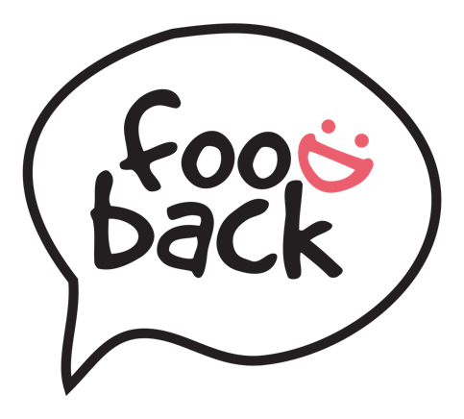
KEY BENEFITS
LARGEST DATA-SET
IT RUNS ITSELF
There is no question – Foodback delivers the largest, most usable data-set in the market.
Customer insights viewed simply on a Real-Time Live dashboard
It sits alongside and complements your existing systems. No extra hands required.
REPEAT GUESTS
STOP RED-FLAG REVIEWS
Finally - A real way to measure and engage your repeat guests. Never have repeat guests been more important..
Save unhappy customers in real-time and protect your brand reputation by stopping bad public reviews before they happen.
SIMPLE & INTUITIVE
FLEXIBILITY FOR F&B
For you and your customers. It was designed for busy people. Easy to use and simple to interpret.
Flexibility that moves with your unique business needs. Dine-in, Take-Away or Home Delivery, Your App, ‘Their’ App or no App.
Notes:
Welcome –
I’d like to take you through a high level view of our agenda today.
Just 6 items that we think will resonate with your business and needs at the current time.
1…… + Std industry collection rate off next day emails (you know, just to the booker) are ~1%,
FBK enables more guests to participate, more voices = more data. All people at the table, all people at home who eat the food etc.
we see data 35% in Canteens and as high as ~90% in dine-in venues
2…..If GX/CX is the heartbeat of your business, Repeat Guests will tell you how healthy you are.
They spend more, they are the best local marketing team you can have, they are cheaper than acquiring new customers…
FBK also keeps them engaged by offering new questions each time. A repeat guest will never see the same question set twice.
3….. + You don’t need a masters degree, and yet its more sophisticated and elegant than a single rating.
(you know the type, a series of happy or frown faces…What does that even tell you?)
Look Ma, No Hands!
It sits alongside and complements existing systems.
No extra hands required – No decisions required to remove existing systems, or embark on unnecessary and costly integrations
5. Stop Red-flag reviews before they happen;
Our instant Alert function means you can save unhappy customers while “its” happening –
not have to dedicate time and staff to mop up the impact of public complaints and reviews.
6. Flexibility that moves with your business needs;
Use FBK in your venue, for take-away or delivery services.
Use FBK in your own APP, In a 3rd Party App, or completely on its own.
Choice is yours.
HERE, TRY IT OUT FOR YOURSELF

Slide 12
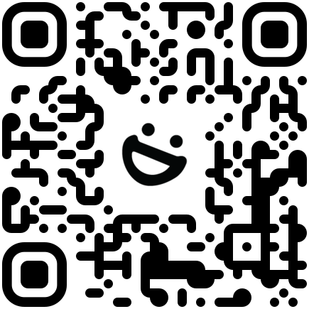
Perhaps even with a QR “portal” (?)
TRY IT FOR
YOURSELF
LARGEST DATA-SET
IT RUNS ITSELF
There is no question – Foodback delivers the largest, most usable data-set in the market.
Customer insights viewed simply on a Real-Time Live dashboard
It sits alongside and complements your existing systems. No extra hands required.
REPEAT GUESTS
STOP RED-FLAG REVIEWS
Finally - A real way to measure and engage your repeat guests. Never have repeat guests been more important..
Save unhappy customers in real-time and protect your brand reputation by stopping bad public reviews before they happen.
SIMPLE & INTUITIVE
FLEXIBILITY FOR F&B
For you and your customers. It was designed for busy people. Easy to use and simple to interpret.
Flexibility that moves with your unique business needs. Dine-in, Take-Away or Home Delivery, Your App, ‘Their’ App or no App.
Notes:
Welcome –
I’d like to take you through a high level view of our agenda today.
Just 6 items that we think will resonate with your business and needs at the current time.
1…… + Std industry collection rate off next day emails (you know, just to the booker) are ~1%,
FBK enables more guests to participate, more voices = more data. All people at the table, all people at home who eat the food etc.
we see data 35% in Canteens and as high as ~90% in dine-in venues
2…..If GX/CX is the heartbeat of your business, Repeat Guests will tell you how healthy you are.
They spend more, they are the best local marketing team you can have, they are cheaper than acquiring new customers…
FBK also keeps them engaged by offering new questions each time. A repeat guest will never see the same question set twice.
3….. + You don’t need a masters degree, and yet its more sophisticated and elegant than a single rating.
(you know the type, a series of happy or frown faces…What does that even tell you?)
Look Ma, No Hands!
It sits alongside and complements existing systems.
No extra hands required – No decisions required to remove existing systems, or embark on unnecessary and costly integrations
5. Stop Red-flag reviews before they happen;
Our instant Alert function means you can save unhappy customers while “its” happening –
not have to dedicate time and staff to mop up the impact of public complaints and reviews.
6. Flexibility that moves with your business needs;
Use FBK in your venue, for take-away or delivery services.
Use FBK in your own APP, In a 3rd Party App, or completely on its own.
Choice is yours.
HERE, TRY IT OUT FOR YOURSELF

Slide 13
FRESH & POWERFUL
Customer Insights
Thomas Laugesen Vice President
(+1) 949 228 5772
ThomasL@foodback.com

